Slide 1
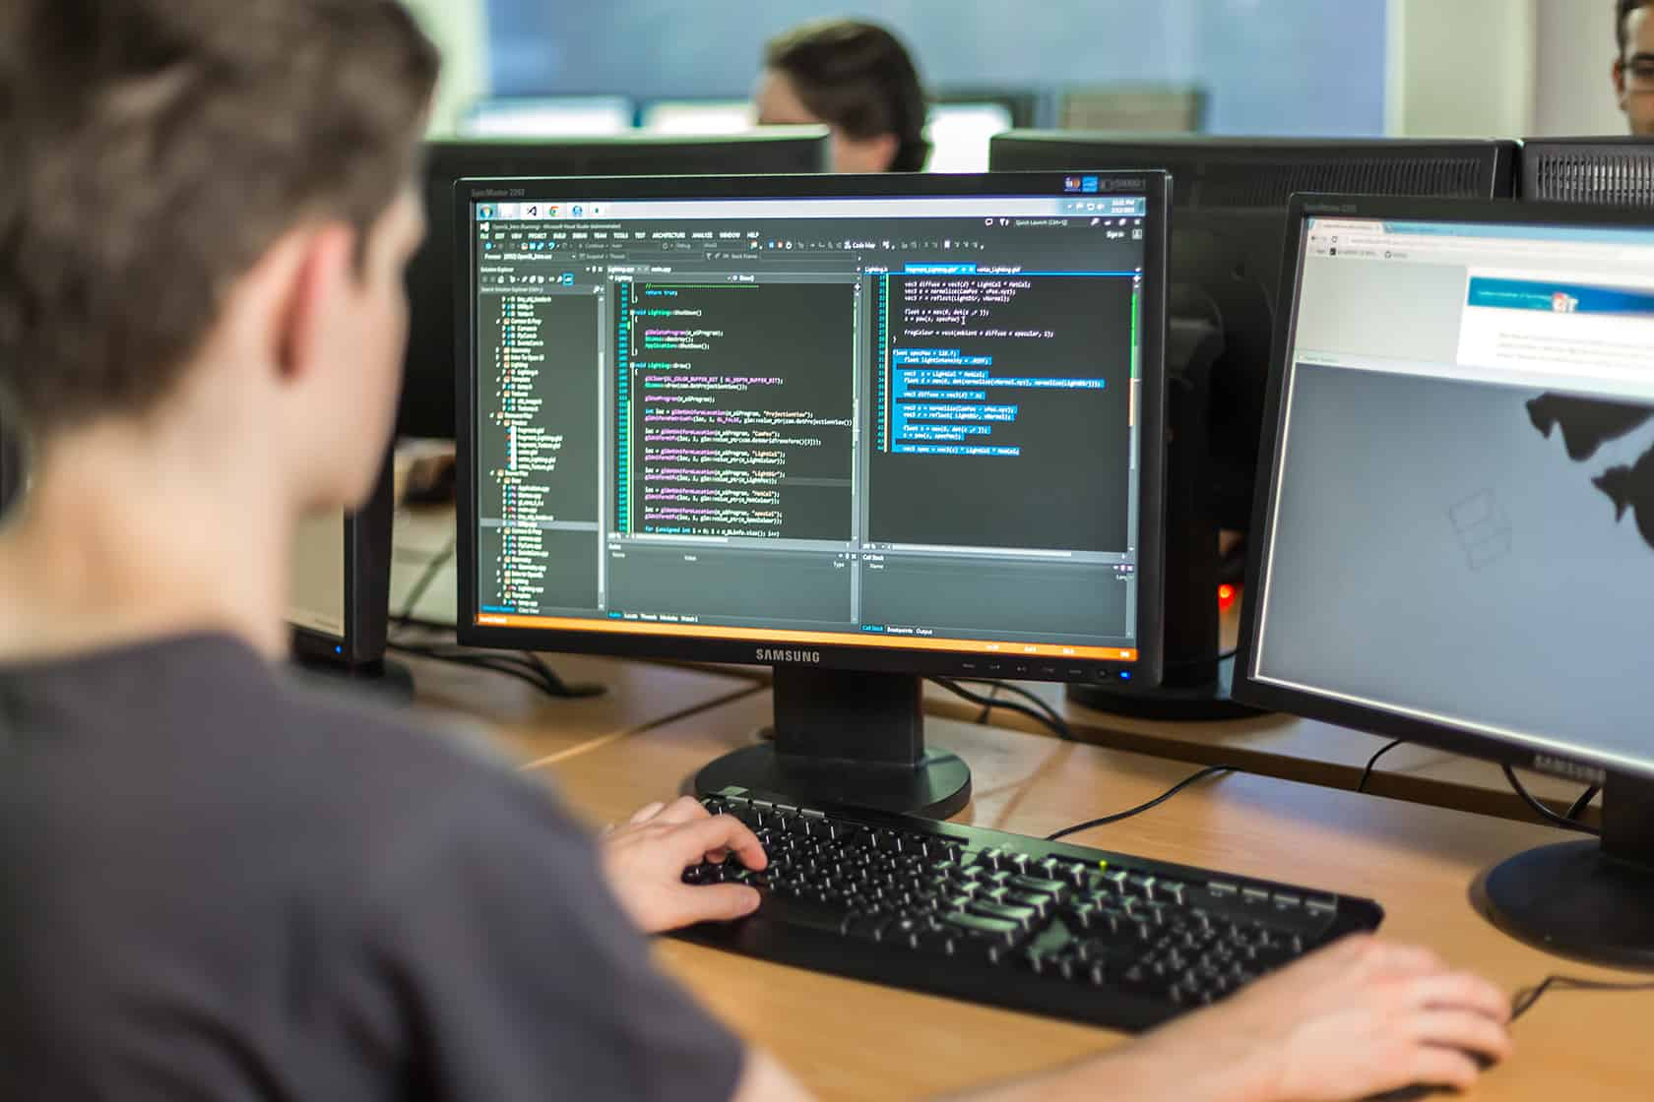
GROUP 8 AIR-QA PROJECT
Trần Công Hải - 21520811
Võ Tín Thiện - 21521467
Nguyễn Khánh Duy - 20521240

Slide 2
Table of contents
01
02
03
04
05
Introduction
Usercase diagram
Features
Demo
Conclusion

Slide 3
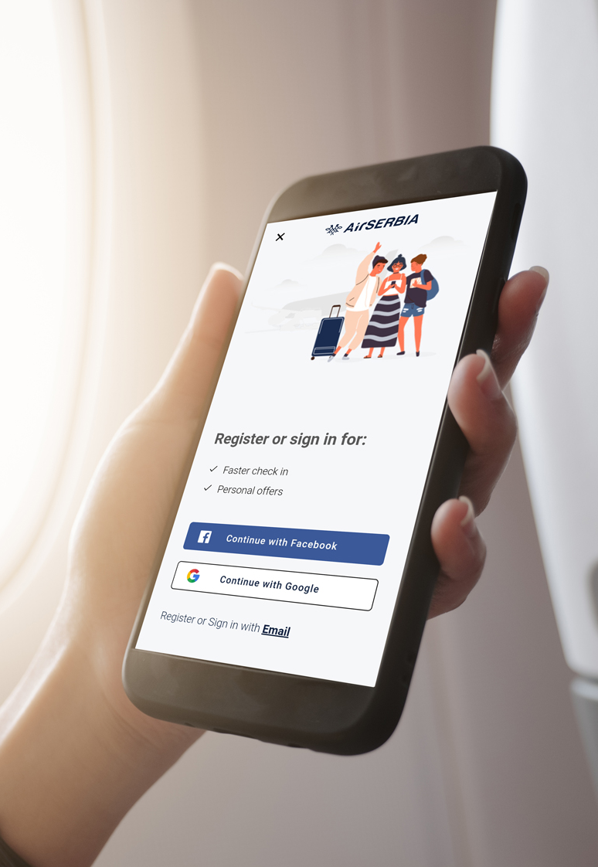
01
Introduction

Slide 4
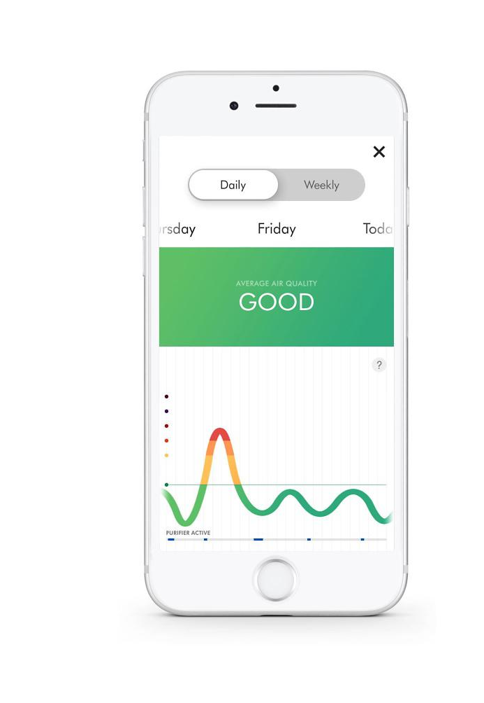
Project overview
+ In today's life, being able to monitor air quality can significantly help us improve our health.
+ This project aims to develop a mobile application that allows users to track various air quality indices along with several other features.

Slide 5



Overview of tools in use
Swagger
Figma
IDE that provides API for the project
Graphic design tool environment for the project
Android Studio
IDE-crafted mobile app

Slide 6

02
Usercase

Slide 7
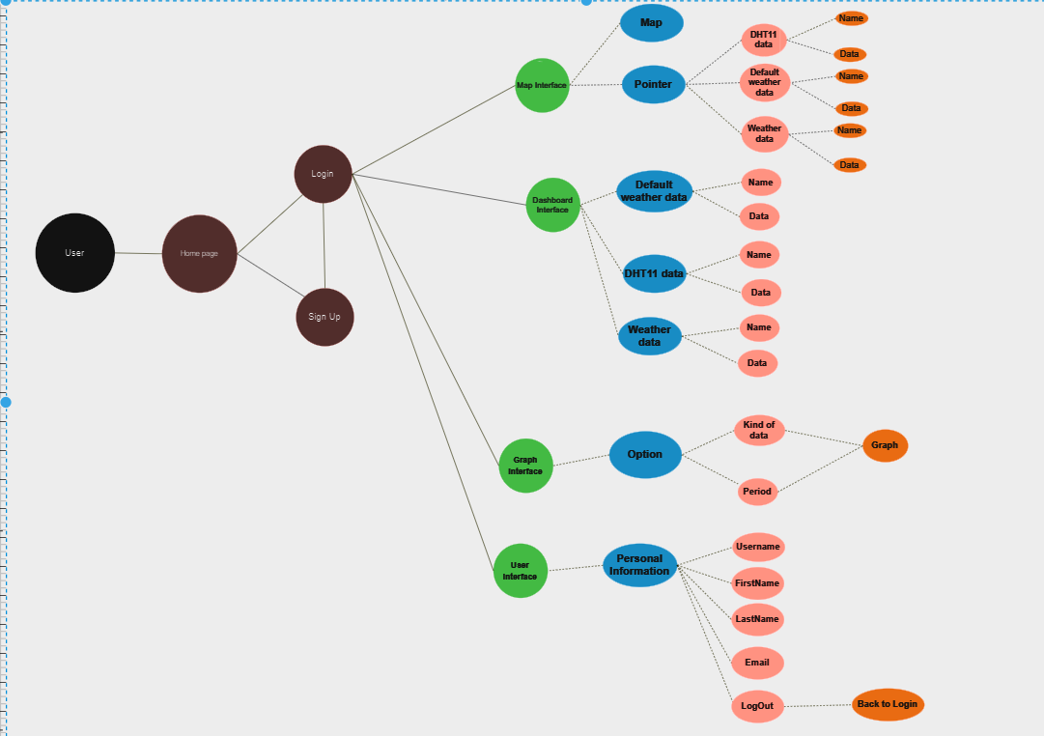
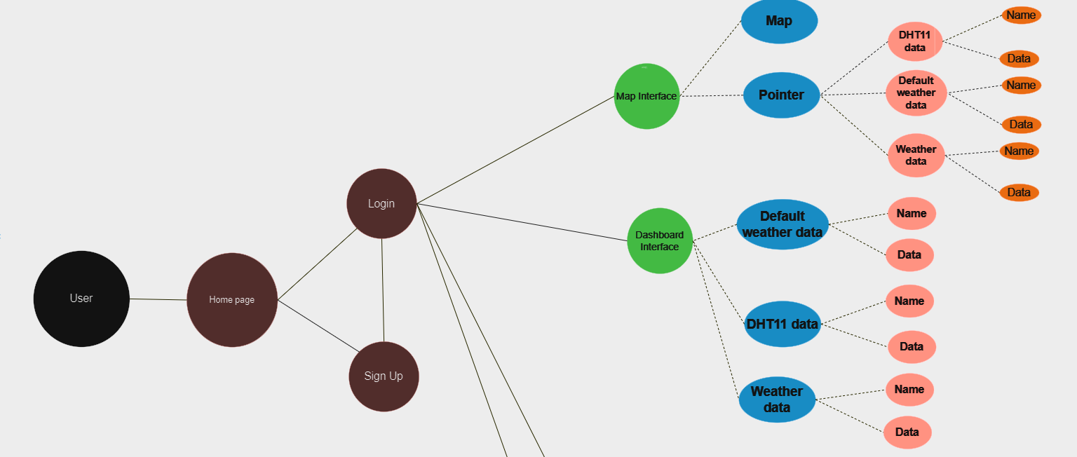
Usercase Diagram

Slide 8
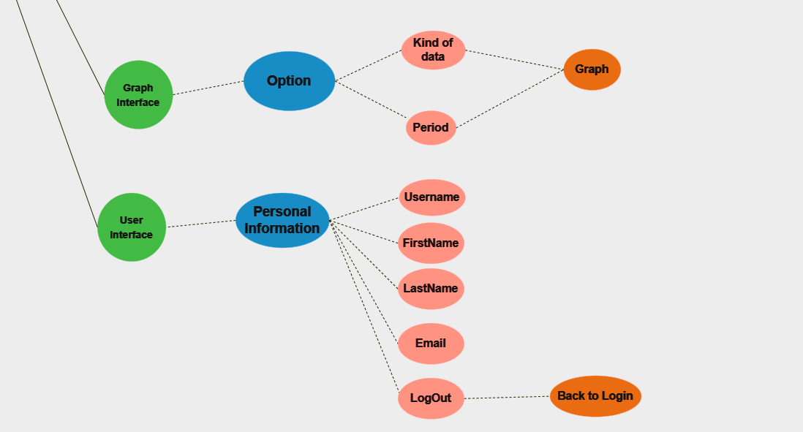

Slide 10
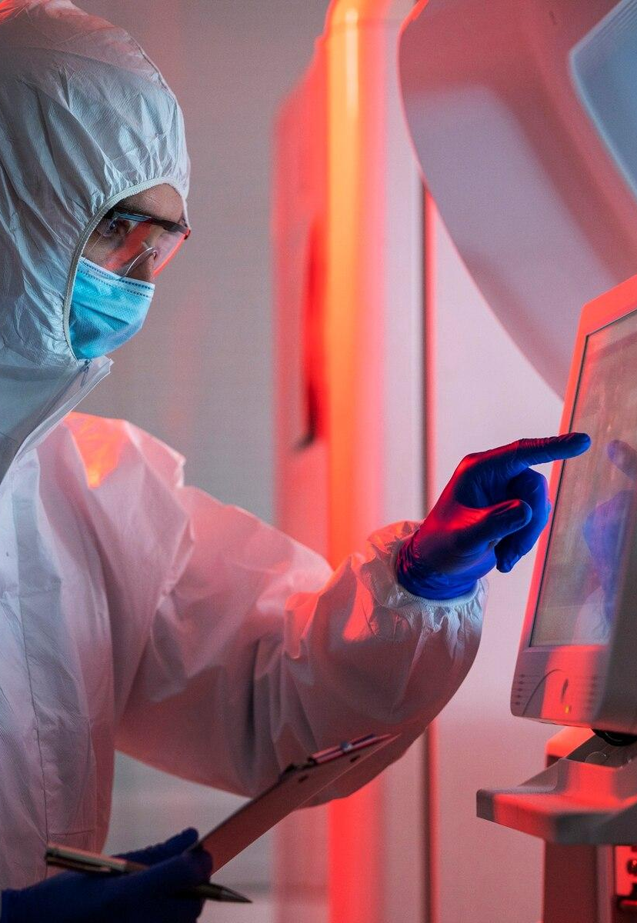
03
Features

Slide 11
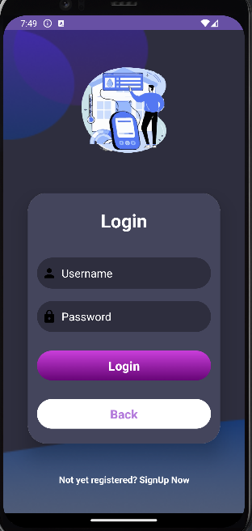
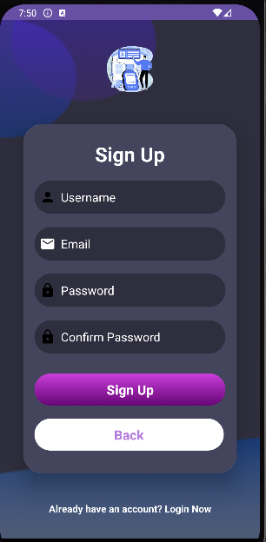
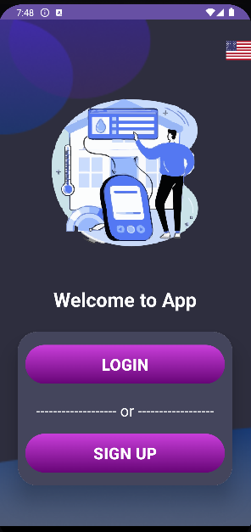
Home page Activity

Slide 12
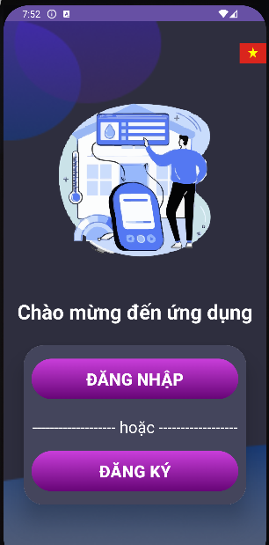
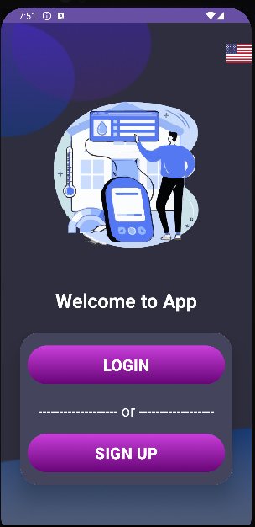
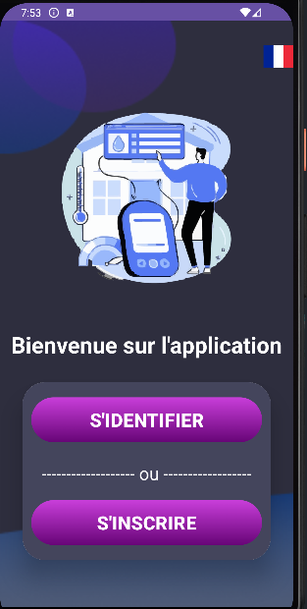
Changing Language Acitivity
Vietnamese
English
France

Slide 13
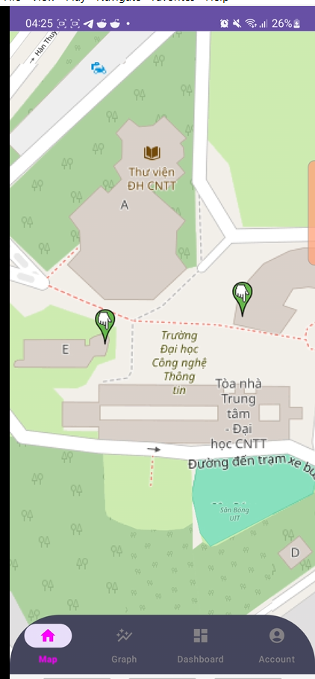
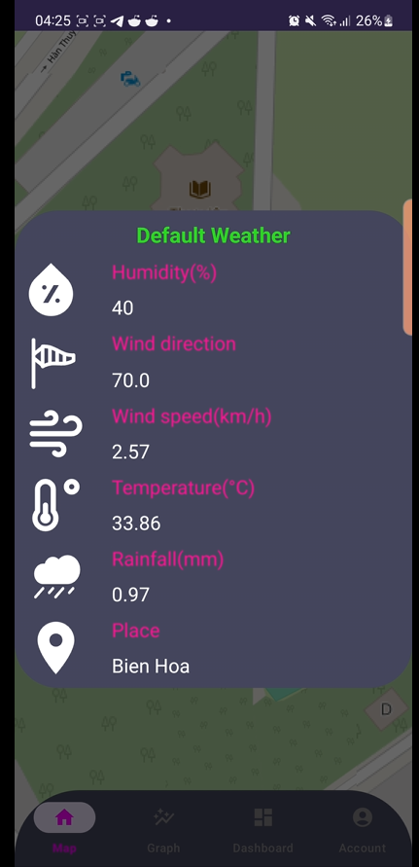
Map Activity
+ You can view the map, zoom in and zoom out
+ The finger pointing icon is the current location of the all of the asset

Slide 14
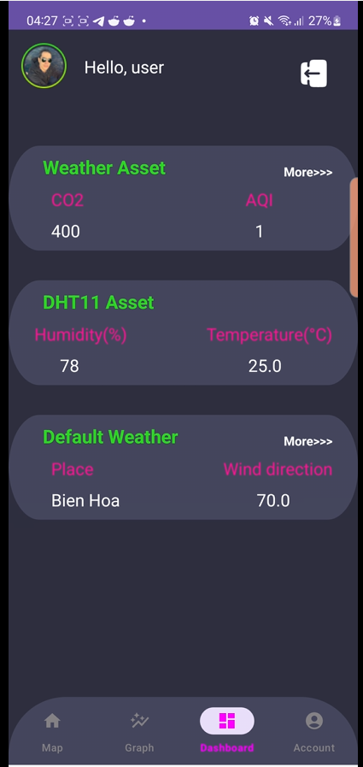
Show Asset Data on Map
- You can see the asset detail name and data by just touch the finger pointing icon

Slide 15
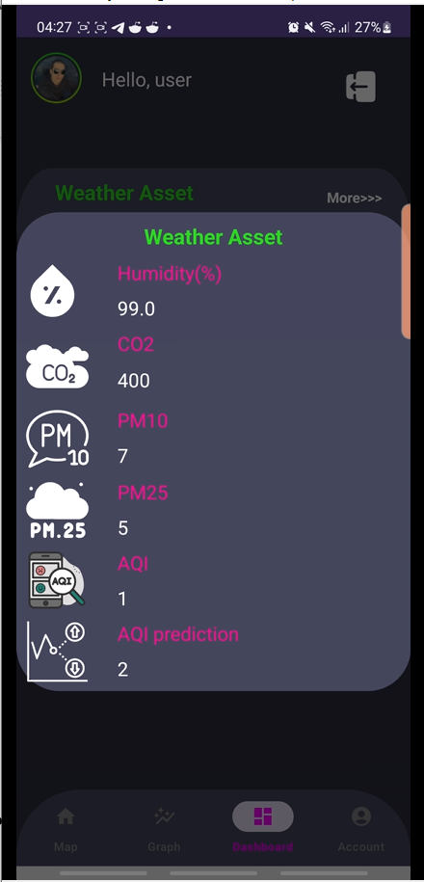
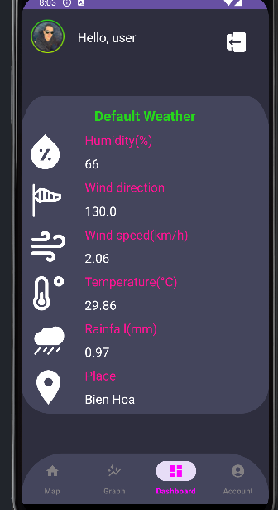
Dashboard activity
- Dashboard Screen give you information about all of current asset

Slide 16
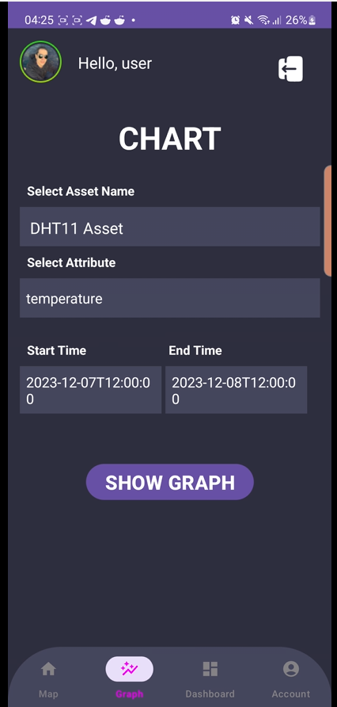
Show more about the Asset Data
If you want to see more all of the Asset information simply touching "More>>>" at the right corner of the Asset Name

Slide 17
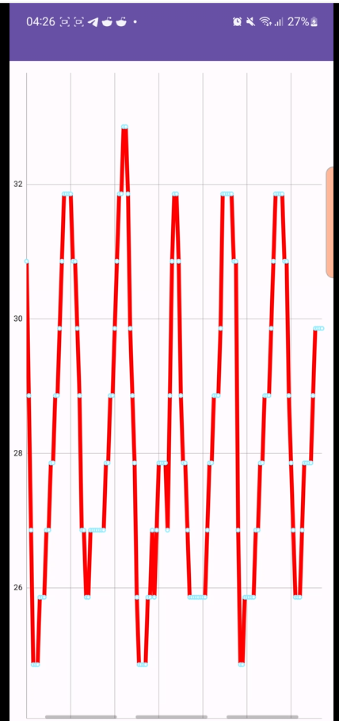
Graph Activity
You can adjust the information before Showing the graph

Slide 18
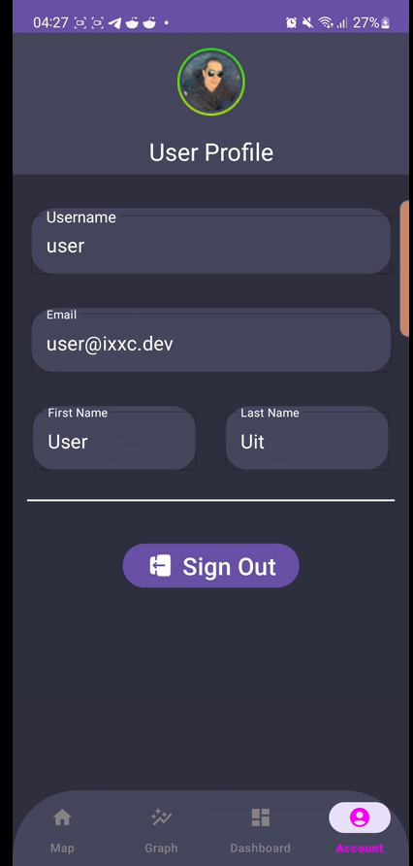
Show Graph Screen
The Graph Screen will appear like this if you touch Show Graph button

Slide 19
User Activity
You can see all of your personal Profile here and you can Sign Out by touching the SignOut button

Slide 20

04
Demo

Slide 21

05
Conclusion

Slide 22

Accomplished Goals
+We have the capability to develop a dependable indoor air quality application, offering a user-friendly interface to track comprehensive weather-related data and more.
+ The application can also track the asset current location, provides user information, show graph,..

Slide 23

Future Improvement
+We aim to enhance the user experience by incorporating additional features and refining the user interface, ensuring a more user-friendly and convenient experience with the app.
+We also aim to integrate AI technology into this project to enable predictive capabilities for parameters such as temperature, humidity, and other related factors.

Slide 24
Thank you
Do you have any questions?
21521467@gm.uit.edu.vn
Please keep this slide for attribution

